Slide 1

Virtual X-ray Simulation By Amber Kaul & Derek Herrera

Slide 2
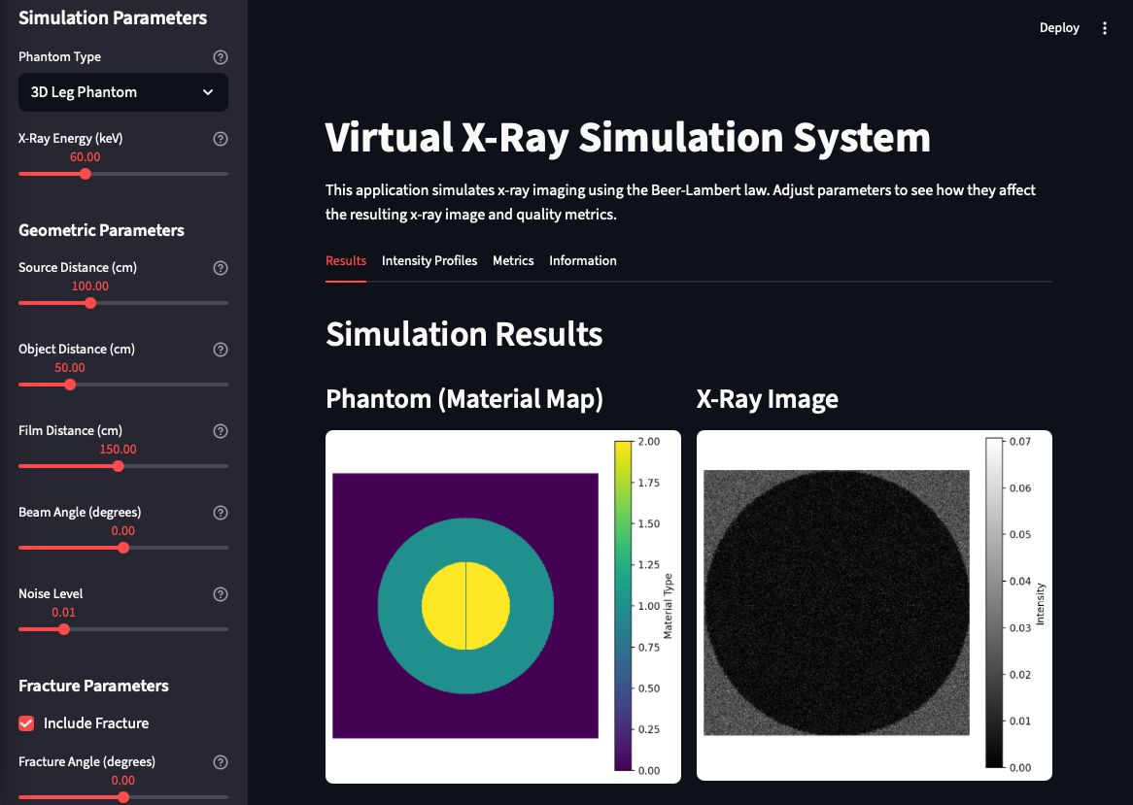
WHAT WE BUILT
Interactive x-ray simulator using Beer-Lambert Law
2D test phantom + 3D leg phantom with fractures
Real-time parameter control
Quality metrics and analysis tools

Slide 3
The Physics used
Beer-Lambert Law: I = I₀ · e^(-μ·d)
Real attenuation data from NIST
Energy range: 20-150 keV
Geometric magnification + realistic noise

Slide 4
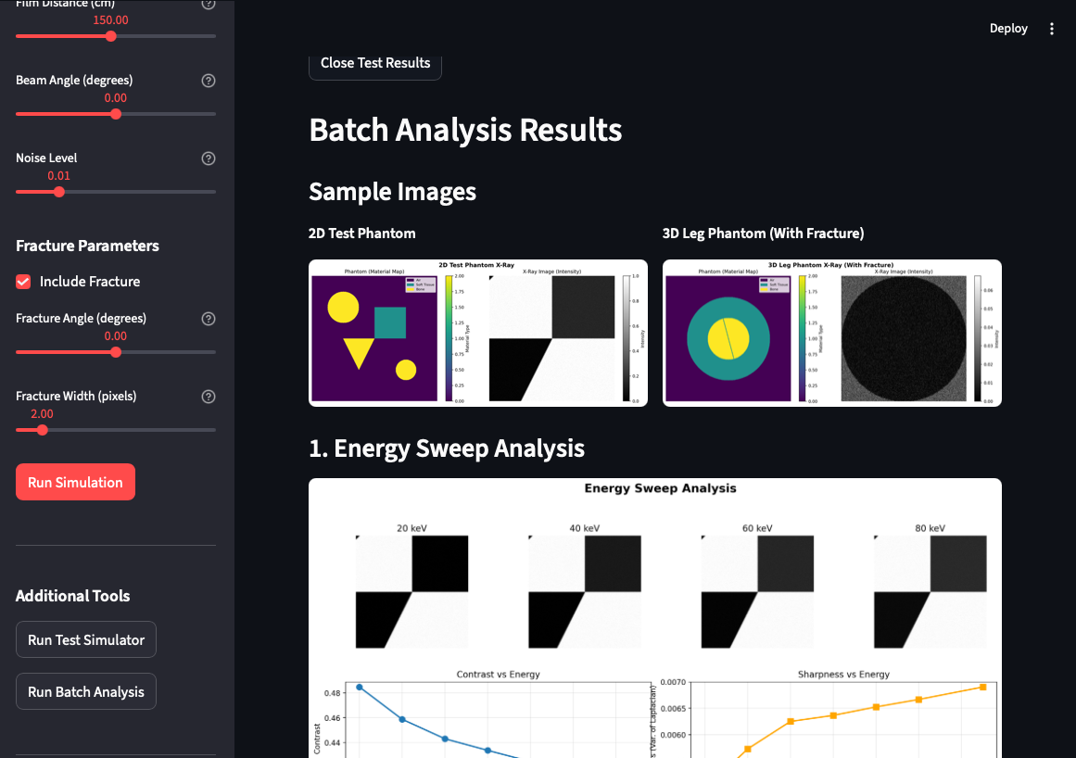
What you can do
Web interface with real-time updates
View images, profiles, and quality metrics
Batch analysis button for parameter sweeps
Test simulator button to verify installation
Fracture visibility studies

Slide 5

HOW THE SIMULATOR WORKS
X-ray imaging modeled using the Beer-Lambert Law I = I0 * exp(-μ * d)
Realistic attenuation values for air, soft tissue, and bone
Modular Python architecture:
XRaySimulator – phantoms, physics, geometry, noise
ImageMetrics – contrast, sharpness, edge strength
BatchAnalysis – automated sweeps for energy, angles, distance, fractures
Streamlit GUI – real-time parameter control
Full Pipeline
Generate phantom (2D or 3D)
Apply beam angle rotation
Compute attenuation projection
Apply magnification and penumbra blur
Add Poisson + Gaussian noise
Display image, metrics, and profiles in the GUI

Slide 6
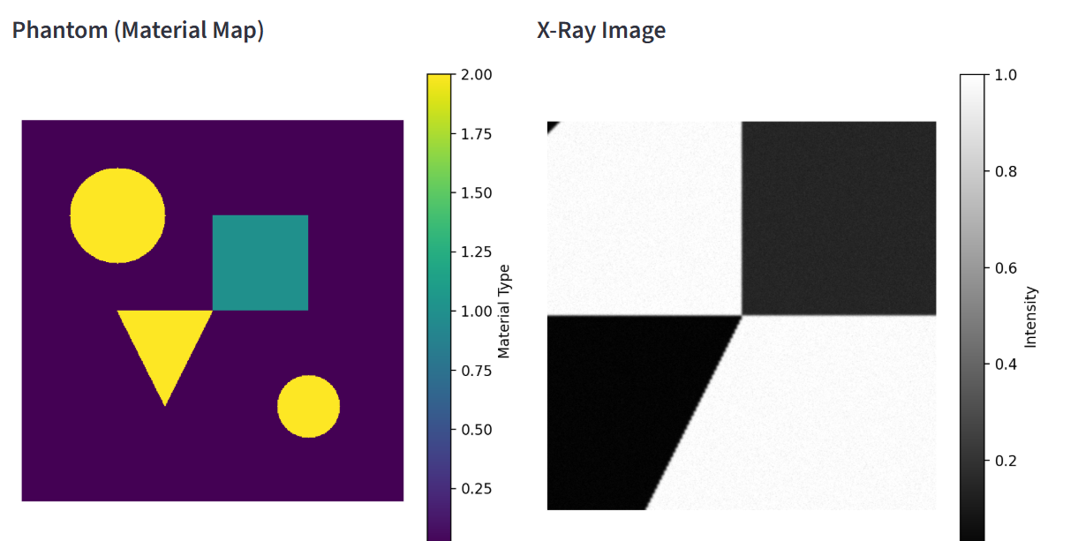
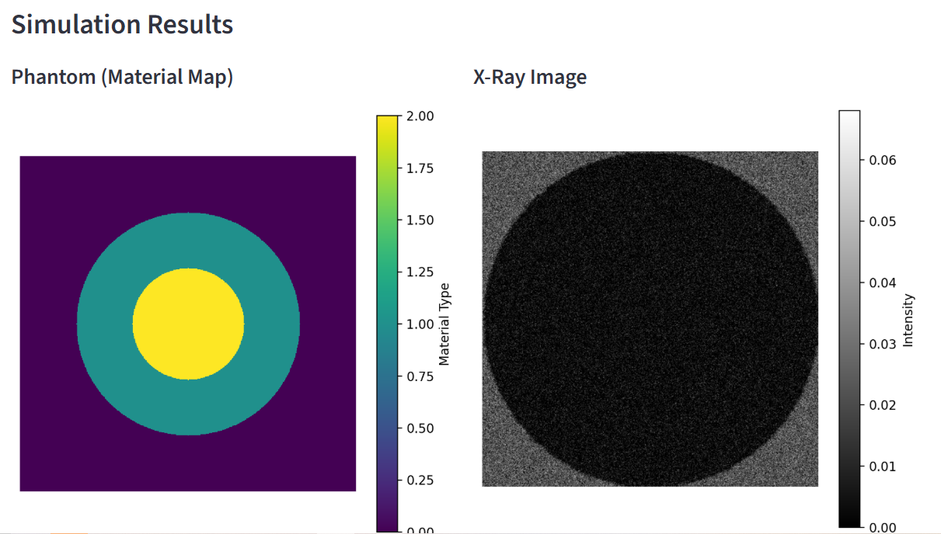
Phantom Models
2D TEST PHANTOM -Contains circles, rectangles, and triangular bone elements -Used to validate geometry, rotation, and attenuation -Produces clean profiles for distance and angle testing
3D LEG PHANTOM -Soft-tissue cylinder + inner bone cylinder -Fracture simulation:
Width (1–5 px)
Angle (0–45°)
Gap carved by removing bone voxels along rotated line -Projected into a 2D x-ray image to study fracture visibility

Slide 7
Geometry & Energy Methods
GEOMETRY MODEL
Magnification: M = film_distance / object_distance
Image rescaled using interpolation
Cropping/padding restores output to 512x512
Penumbra blur: blur = max(0.1, (film_distance - object_distance) / source_distance)
ENERGY MODEL
μ(E) values retrieved via interpolation
Low energy → high contrast (strong attenuation differences)
High energy → lower contrast, higher transmission
BEAM ANGLE
Phantom rotated before attenuation projection
Used to study A-P, oblique, and angled views

Slide 8
Key Results: 2D Phantom
DISTANCE EFFECTS
Changing source and object distance alters magnification and edge sharpness
Film distance has comparatively small influence on the final image
These tests validated the geometry pipeline (magnification + penumbra blur)
ENERGY EFFECTS
As energy increases, contrast decreases because attenuation coefficients for different tissues converge
Mean intensity increases at higher energy, reflecting greater transmission through all materials
Edge strength and sharpness change only slightly, consistent with stable geometric structure
METRIC INSIGHTS
Contrast, sharpness, gradient entropy, and edge strength provide quantitative confirmation of visual trends
Metrics let us compare parameter sweeps objectively rather than relying only on images
The smooth, monotonic behavior across energy levels verifies that the Beer-Lambert and μ-lookup system is implemented correctly
These measurements establish a foundation for evaluating more complex cases like 3D fracture visibility
BEAM ANGLE EFFECTS
Rotating the beam shifts and distorts the projected anatomy
Profiles change shape even when global metrics remain stable, demonstrating the value of visual + numerical assessment

Slide 9
Key Results: 3D Leg Phantom & Fractures
FRACTURE WIDTH
Narrow width → thin, subtle line
Wider fractures → darker, more distinct separation in bone
Fracture contrast increases with width
FRACTURE ANGLE
0° fracture → sharp, clean vertical separation
Oblique fractures → appear smeared due to multi-slice overlap
More difficult to visually isolate compared to perpendicular fractures
APPLICATIONS
Demonstrates how x-ray geometry affects fracture detectability
Provides a sandbox for studying imaging physics and diagnostic visibility

